Slide 1
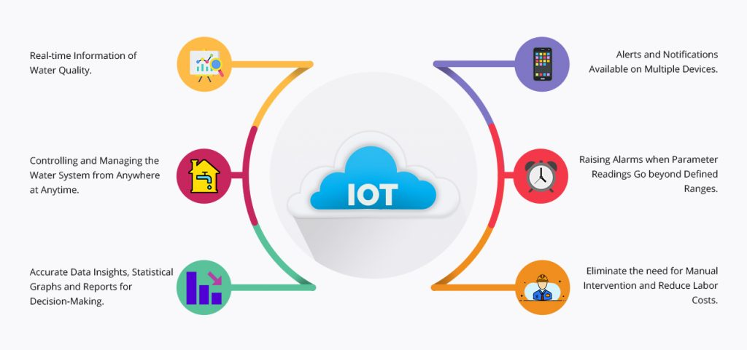
ABSTRACT
by team Technocrats
Group members:
Swagat Nayak
-8018090345
-swagatsony1430@gmail.com
Vishal Kumar
-6205594943
-vishalkumarnke93@gmail.com

Slide 2
Problem Statement
Need for water quality measurement at industrial and household levels and it’s management.

Slide 3
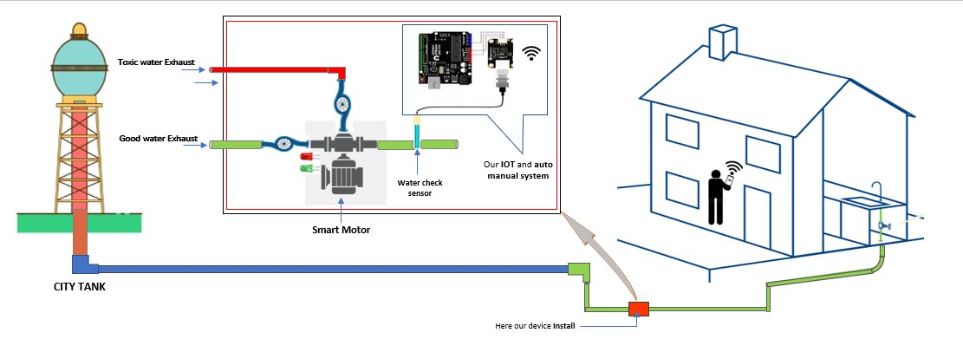
Solution
Our project focuses on monitoring water quality with respect to the usage.
We are making a product that can detect the TDS levels of water and either stop or divert the water with high TDS.
Our product will also send an alert to the user through IoT about the quality of water.

Slide 4
Working
The TDS sensor in our microcontroller based system will detect the amount of free ions by measuring the conductivity aof supply water.
If the amount of total dissolved solids in water is above normal level i.e. 150 ppm then the TDS sensor will detect it.
The Arduino after receiving the signal, activates the pump that sends the contaminated water to a separate tank.
If the TDS sensor detects drinkable water again i.e. TDS amount is below 150 ppm, then the Arduino activates the pump that will send the water to the tank.
The ESP32 connected with the arduino will also send an alert to the owner using IoT on detecting contaminated water.

Slide 5
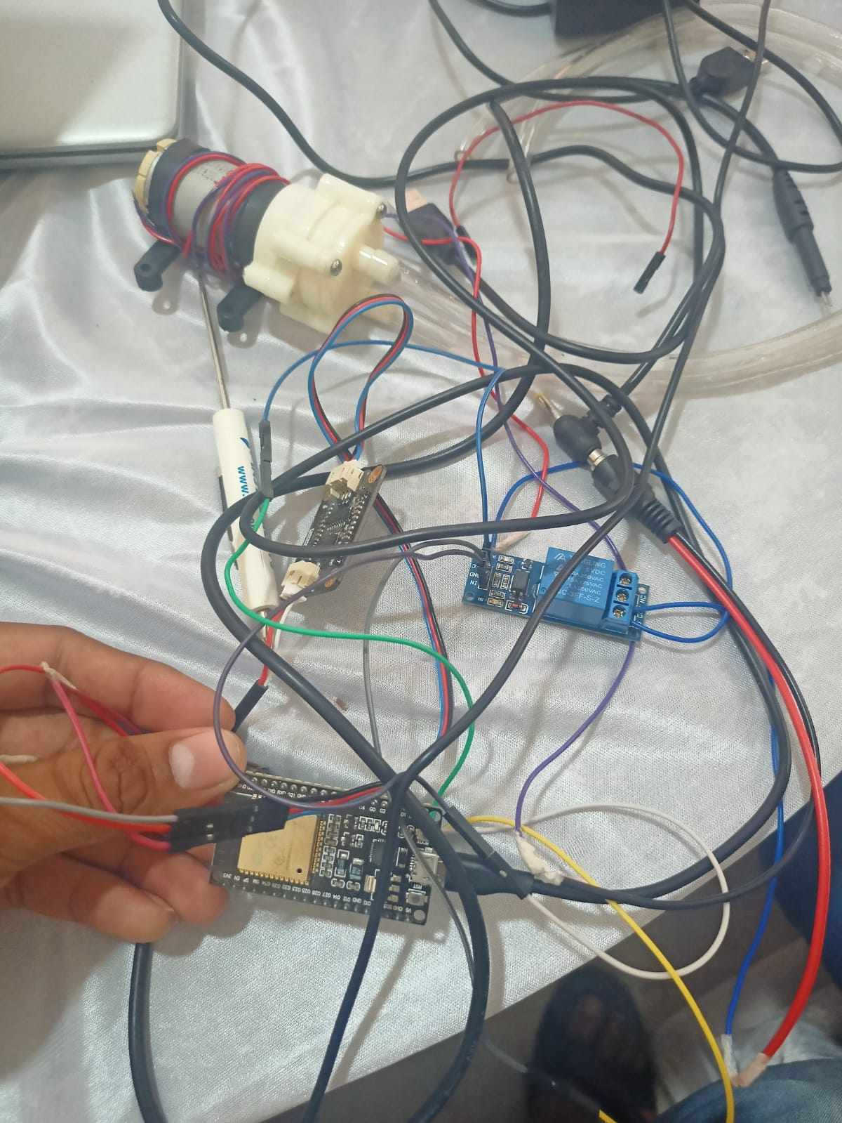
Circuit

Slide 6
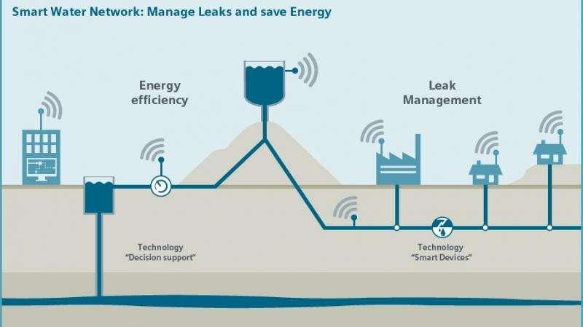
Use Cases
Household needs
Commercial purpose
Municipality purpose
Laboratory needs
Industry needs
Ground water and surface water quality

Slide 7
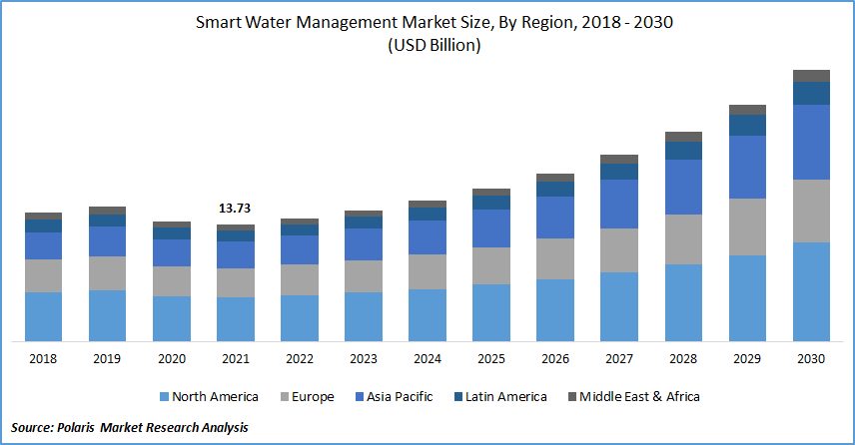
Marketing
The global smart water management market size was valued at USD 13.8 billion in 2021 and is projected to expand at a CAGR of 10.1% to 22.4 billion till 2026.

Slide 8
Government initiatives and regulations are boosting the investments towards modernising water structure.
Acquisitions and product launches would offer lucrative offers for the market players in the next 5 years.
The market growth in APAC can be attributed to the high adoption of IoT hardware, enhancing the need for efficient smart water management solutions.

Slide 9
Thank You

